Slide 1
Sorting & Searching
CSE 2050
Ahmad Jbara
University of Connecticut

Slide 2
Searching…
It’s the algorithmic process of finding a particular item in a collection of items
Returns True if the item exists and false if not
Two algorithms:
Linear search
Binary search

Slide 3
Linear search
def seqSearch(L, x): pos = 0 n = len(L) while pos < n: if L[pos] == x: return True pos = pos + 1 return False
The common step repeated to solve the problem is comparison
Counting number of comparisons: O(n)

Slide 4
Binary search
Assume sorted list
def bs(L, x): left, right = 0, len(L) -1 while left <= right: mid = (right + left) // 2 if L[mid] == x: return True elif x < L[mid]: right = mid - 1 else: left = mid + 1 return False

Slide 5
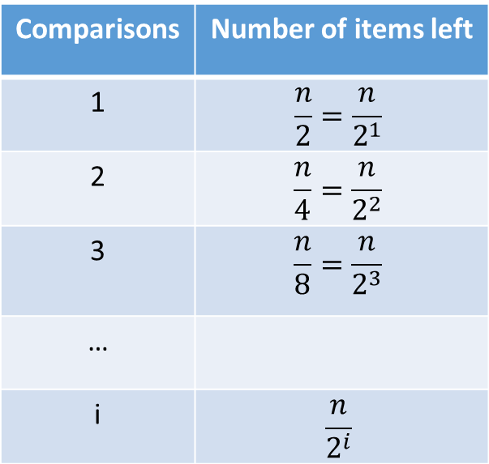
Analysis of binary search
Each comparison eliminates about half of the remaining elements
What is the maximum number of comparisons required to check the entrie list?
Comparisons | Number of items left
1 | $$\frac{n}{2}=\frac{n}{2^{1}}$$
2 | $$\frac{n}{4}=\frac{n}{2^{2}}$$
3 | $$\frac{n}{8}=\frac{n}{2^{3}}$$
…
i | $$\frac{n}{2^{i}}$$

Slide 6
Analysis of binary search
When we split the list enough (i times) we end up with one element
It could be the element we are looking for or not
Either way, we are done.
Comparisons | Number of items left
1 | $$\frac{n}{2}=\frac{n}{2^{1}}$$
2 | $$\frac{n}{4}=\frac{n}{2^{2}}$$
3 | $$\frac{n}{8}=\frac{n}{2^{3}}$$
…
i | $$\frac{n}{2^{i}}$$

Slide 7
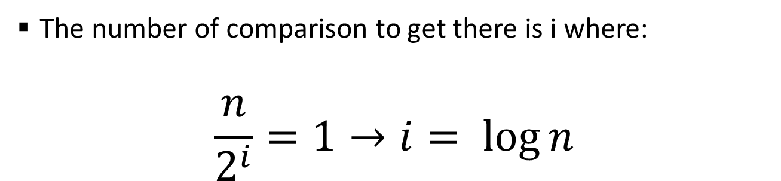
Analysis of binary search
The number of comparison to get there is i where:
$$\frac{n}{2^{i}}=1→i= \log{n}$$
Comparisons | Number of items left
1 | $$\frac{n}{2}=\frac{n}{2^{1}}$$
2 | $$\frac{n}{4}=\frac{n}{2^{2}}$$
3 | $$\frac{n}{8}=\frac{n}{2^{3}}$$
…
i | $$\frac{n}{2^{i}}$$

Slide 8
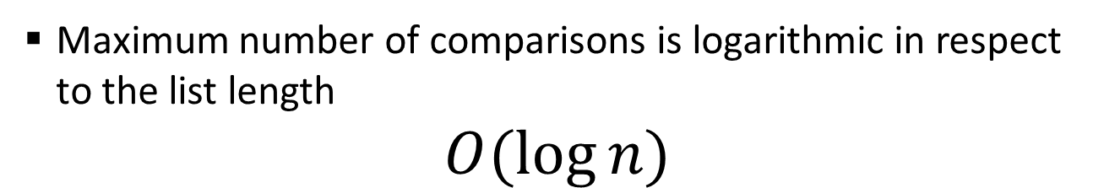
Analysis of binary search
Maximum number of comparisons is logarithmic in respect to the list length
$$O(\log{n})$$
Comparisons | Number of items left
1 | $$\frac{n}{2}=\frac{n}{2^{1}}$$
2 | $$\frac{n}{4}=\frac{n}{2^{2}}$$
3 | $$\frac{n}{8}=\frac{n}{2^{3}}$$
…
i | $$\frac{n}{2^{i}}$$

Slide 9
Binary search – recursive 1
Assume sorted list
def bs(L, x):
if len(L) == 0:
return False
mid = len(L) // 2
if L[mid] == x:
return True
elif x < L[mid]:
return bs(L[:mid], x)
else:
return bs(L[mid + 1 :], x)

Slide 10
Binary search – recursive 2
Assume sorted list
def bs(L, x, left, right):
if left > right:
return False
mid = (left + right) // 2
if L[mid] == x:
return True
elif x < L[mid]:
return bs(L, x, left, mid - 1) else:
return bs(L, x, mid + 1, right)

Slide 11
The SortedList ADT
Operation | Description
SortedList() | Creates a new ordered list that is empty.
add(item) | Adds item to the sorted list
remove(item) | Removes the first occurrence of item
__getitem__(index) | Returns the item with the given index
__contains__(item) | Returns True if there is an item equal to item
__iter__ | Returns an iterator over the sorted list
__len__ | Returns the length of the sorted list

Slide 12
Implementation of SortedList ADT using list
class SimpleSortedList:
def __init__(self):
self._L = []
def add(self, item):
self._L.append(item)
self._L.sort()
def remove(self, item):
self._L.remove(item)
def __getitem__(self, index):
return self._L[index]
def __contains__(self, item):
return item in self._L
def __len__(self):
return len(self._L)
def __iter__(self):
return iter(self._L)

Slide 13
Implementation of SortedList ADT using list
class BSSortedList(SimpleSortedList):
def __contains__(self, item):
left, right = 0, len(L) -1 while left <= right: mid = (right + left) // 2 if L[mid] == x: return True elif x < L[mid]: right = mid - 1 else: left = mid + 1 return False

Slide 14
Implementation of SortedList ADT using linkedlist
from listnode import ListNode
class SortedList:
def __init__(self):
self._head = None
def add(self, item):
current = self._head
previous = None
while current != None:
if current._data > item:
break
else:
previous = current
current = current._link
temp = ListNode(item)
if previous == None:
temp._link = self._head
self._head = temp
else:
temp._link = current
previous._link = temp

Slide 15
Implementation of SortedList ADT using linkedlist
from listnode import ListNode
class SortedList:
…
def sort(self):
outer = self._head
while outer != None:
inner = self._head
while inner._link != None:
if inner._data > inner._link._data:
data = inner._data
inner._data = inner._link._data
inner._link._data = data
inner = inner._link
outer = outer._link

Slide 16
Implementation of SortedList ADT using linkedlist
from listnode import ListNode
class SortedList:
def __init__(self):
self._head = None
def add(self, item):
current = self._head
previous = None
while current != None:
if current._data > item:
break
else:
previous = current
current = current._link
temp = ListNode(item)
if previous == None:
temp._link = self._head
self._head = temp
else:
temp._link = current
previous._link = temp

Slide 17
Implementation of SortedList ADT using linkedlist and generic comparison
from listnode import ListNode
class SortedList:
def __init__(self, cmp):
self._head = None
self._cmp = cmp
def add(self, item):
current = self._head
previous = None
while current != None:
if self._cmp (current._data, item) > 0:
break
else:
previous = current
current = current._link
temp = ListNode(item)
if previous == None:
temp._link = self._head
self._head = temp
else:
temp._link = current
previous._link = temp

Slide 18
Implementation of SortedList ADT using linkedlist and generic comparison
from listnode import ListNode
class SortedList:
…
def __str__(self):
current = self._head
res = ""
while current != None:
res += str(current._data) + " "
current = current._link
return res.strip()
def setKey(self, cmp):
self._cmp = cmp
self.sort()

Slide 19
Implementation of SortedList ADT using linkedlist and generic comparison
from listnode import ListNode
class SortedList:
…
def sort(self):
outer = self._head
while outer != None:
inner = self._head
while inner._link != None:
if self._cmp (inner._data, inner._link._data) > 0:
data = inner._data
inner._data = inner._link._data
inner._link._data = data
inner = inner._link
outer = outer._link

Slide 20
Implementation of SortedList ADT using linkedlist
def intCmp(x, y):
return x - y
def sumCmp(x, y):
return x%10 - y%10
l = SortedList(intCmp)
l.add(8)
l.add(29)
l.add(51)
l.add(10)
print(l)
l.setKey(sumCmp)
print(l)
def nameCmp(x, y):
if x[0] > y[0]:
return 1
elif x[0] < y[0]:
return -1
else:
return 0
def ageCmp(x, y):
if x[1] > y[1]:
return 1
elif x[1] < y[1]:
return -1
else:
return 0
l = SortedList(nameCmp)
l.add(("Justin", 23))
l.add(("Jessie",29))
l.add(("Sarah", 25))
print(l)
l.setKey(ageCmp)
print(l)

Slide 21
Quadratic-time sorting algorithms
Determine if a given list L is sorted
def is_sorted(L):
for i in range(len(L)‑1):
if L[i]>L[i+1]:
return False
return True
print(is_sorted([1,2,3,4,5]))
print(is_sorted([1,4,5,7,2]))

Slide 22
Quadratic-time sorting algorithms
Determine if a given list L is sorted
def is_sorted_slow(L):
for i in range(len(L)‑1):
for j in range(i+1, len(L))
if L[j] < L[i]:
return False
return True

Slide 23
Quadratic-time sorting algorithms
Instead of returning False we will swap
It will move the largest element to the end
def dumberSort(L):
for i in range(len(L)‑1):
if L[i]>L[i+1]:
L[i], L[i+1] = L[i+1], L[i]

Slide 24
Quadratic-time sorting algorithms
It’s O(n²), a quadratic time algorithm
def bubbleSort(L):
for j in range(len(L)‑1):
for i in range(len(L)‑1):
if L[i]>L[i+1]:
L[i], L[i+1] = L[i+1], L[i]

Slide 25
The invariant
There's a guarantee that after j iterations, then the j largest elements of the list are in the correct order at the end of the list.
An invariant is a condition that can be relied upon to be true during execution of a program, or during some portion of it. It is a logical assertion that is held to always be true during a certain phase of execution.
- Wikipedia

Slide 26
Quadratic-time sorting algorithms
It’s O(n²), a quadratic time algorithm
def bubbleSort(L):
keepgoing = True
while keepgoing:
keepgoing = False
for i in range(len(L)‑1):
if L[i]>L[i+1]:
L[i], L[i+1] = L[i+1], L[i]
keepgoing = True

Slide 27
Quadratic-time sorting algorithms
It’s O(n²), a quadratic time algorithm
Focusing on the invariant, we want to move the i^{th} largest element to i^{th} place from the end – we can save swaps
def selectionSort(L):
n = len(L)
for i in range(n‑1):
max_index=0
for index in range(n ‑ i):
if L[index] > L[max_index]:
max_index = index
L[n‑i‑1], L[max_index] = L[max_index], L[n‑i‑1]

Slide 28
Quadratic-time sorting algorithms
It’s O(n²), a quadratic time algorithm
def insertionSort(L):
n = len(L)
for i in range(n):
for j in range(n‑i‑1, n‑1):
if L[j]>L[j+1]:
L[j], L[j+1] = L[j+1], L[j]

Slide 29
Sorting in Python
“sorted” creates a new sorted list
“sort” sorts the list
X = [3,1,5]
Y = sorted(X)
print(X, Y)
X.sort()
print(X)

Slide 30
Divide & conquer paradigm
A paradigm for algorithm design
Consists of 3 parts:
Divide – divide the problem into smaller pieces
Conquer – solve the problem for the smaller pieces (recursive)
Combine – combine the solutions of the smaller pieces into a solution for the big problem

Slide 31
Recursion
Assume list is not empty
def myMax1(L):
if len(L) == 1:
return L[0]
mx = myMax1(L[:-1])
if mx > L[-1]:
return mx
return L[-1]
def myMax2(L):
if len(L) == 1:
return L[0]
mid = len(L)//2
mxL = myMax2(L[:mid])
mxR = myMax2(L[mid:])
if mxL > mxR:
return mxL
return mxR

Slide 32
Recursion
Assume list is not empty
def myMax3(L, left, right):
if left == right:
return L[left]
mxL = myMax3(L,left,right-1)
if mxL > L[right]:
return mxL
return L[right]
def myMax4(L, left, right):
if left == right:
return L[left]
mid = (left + right)//2
mxL = myMax4(L, left, mid)
mxR=myMax4(L,mid+1,right)
if mxL > mxR:
return mxL
return mxR

Slide 33
Mergesort algorithm
Application of the Divide & Conquer paradigm to the sorting problem
def merge(A, B, L):
i = 0
j = 0
while i < len(A) and j < len(B):
if A[i] < B[j]:
L[i+j] = A[i]
i = i + 1
else:
L[i+j] = B[j]
j = j + 1
L[i+j:] = A[i:] + B[j:]
def mergeSort(L):
if len(L) < 2:
return
mid = len(L) // 2
A = L[:mid]
B = L[mid:]
mergeSort(A)
mergeSort(B)
merge(A, B, L)

Slide 34
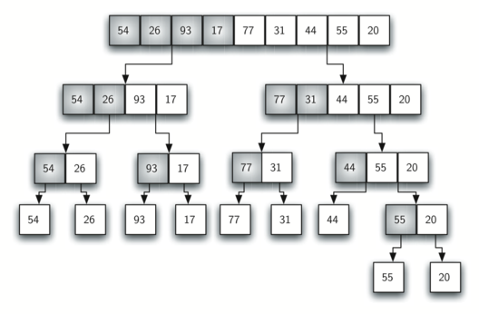
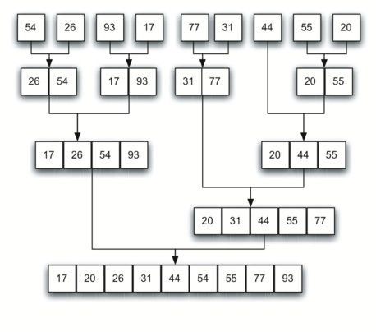
Mergesort analysis
http://interactivepython.org/runestone/static/pythonds/SortSearch/TheMergeSort.html

Slide 35
Mergesort algorithm
n
n/2
n/2
n/4
n/4
n/4
n/4
logn
http://interactivepython.org/runestone/static/pythonds/SortSearch/TheMergeSort.html

Slide 36
Mergesort analysis
Will count the basic operations in the methods without recursive calls
Drawing the tree of recursive calls
Writing the cost of each function call in the tree
Then add them all up to get the total running time

Slide 37
Mergesort analysis
The merge function for two lists that add up to n will take O(n)
Comparison and assignment of each element that added to the new list that will contain n elements.
In the recursive tree we have logn levels each costs O(n)
The total cost is O(nlogn)

Slide 38
Quicksort
Mergesort does a lot of slicing
Slicing creates copies
Mergesort essential part is ‘combining’
Quicksort uses divide and conquer
It does not use additional storage
Arranging elements in a single list is called in-place sorting
Quicksort hard step is ‘dividing’
It is possible that the list may not be divided in half

Slide 39
Quicksort
The key idea in quicksort:
Partition the list around a pivot – can be done in linear time
Pivot assists with splitting the list
Items left to the pivot are less than the pivot
Item right to the pivot are greater than the pivot
Can be done in-place
Worst-case → O(n²)
Can do better if pivot near the middle (median)
After partitioning two things are true:
The pivot is in its final location in the list
The two sublists are now smaller and therefore can be quicksorted

Slide 40
Quicksort – v1
def quickSorted(L):
if len(L) < 2: # base case
return L[:]
pivot = L[‑1] # dividing
LT = [e for e in L if e < pivot]
ET = [e for e in L if e == pivot]
GT = [e for e in L if e > pivot]
A = quickSorted(LT)
B = quickSorted(GT)
return A + ET + B # combining

Slide 41
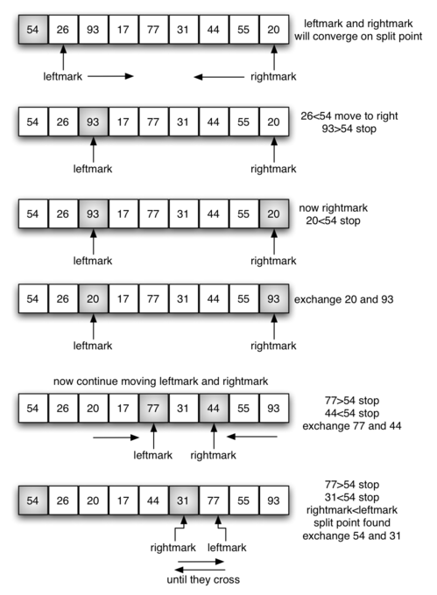
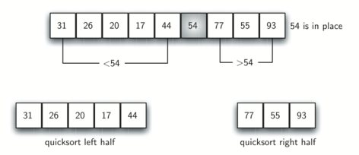
Partitioning

Slide 42
Quicksort – in-place version
def partition(L, left, right):
pivot = right ‑ 1
i = left
j = pivot ‑ 1
while i < j:
while L[i] < L[pivot]:
i = i + 1
while i < j and L[j] >= L[pivot]:
j = j ‑ 1
if i < j:
L[i], L[j] = L[j], L[i]
if L[pivot] <= L[i]:
L[pivot], L[i] = L[i], L[pivot]
pivot = i
return pivot

Slide 43
Quicksort – in-place version
def quicksort(L, left = 0, right = None):
if right is None:
right = len(L)
if right ‑ left > 1:
mid = partition(L, left, right) # divide
quicksort(L, left, mid) #conquer
quicksort(L, mid+1, right) # conquer
# Combine!
# Nothing to do!

Slide 44
Analysis
The length of the list is n
If the partition always occurs in the middle we will have logn divisions
To find the split point each of the n items needs to be checked against the pivot
Time complexity: O(nlogn)

Slide 45
Analysis - unfortunately
In the worst-case the split point might not be in the middle
It might be skewed to the left or to the right
This yields uneven division
In this case the list splits into two lists of
0 items
n-1 items
Time complexity: O(n²)

Slide 46
Links to YouTube videos
BINARY search with FLAMENCO dance
Bubble-sort with Hungarian folk dance
Merge-sort with Transylvanian-saxon (German) folk dance
Quick-sort with Hungarian (Küküllőmenti legényes) folk dance

